Slide 1

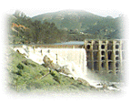
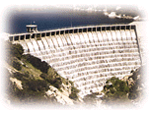
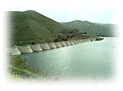
Public Utilities Department
( (Water Operations Branch)
Surface Reservoir Storage Operations
2011

Slide 2
San Diego Water System Facts
Serves Population of Over 1.3 million
Over 275,000 Meter Connections
Service Area of 403 Square Miles
Over 130 Distribution System Pressure Zones
Over 3,300 Miles of Pipelines
24 Distribution Reservoirs and Standpipes
49 Distribution System Pump Stations
FY2011 Average Daily Consumption of 171 MGD (192,000 AF/YR Demand)

Slide 3
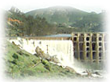
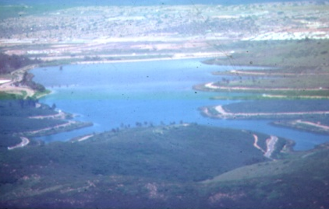
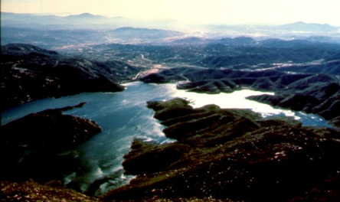
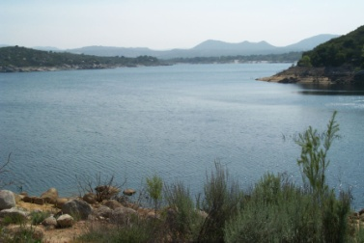
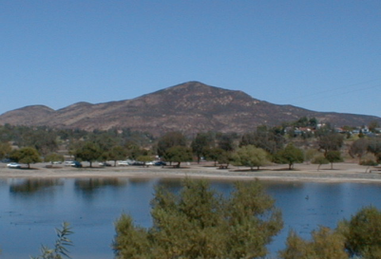
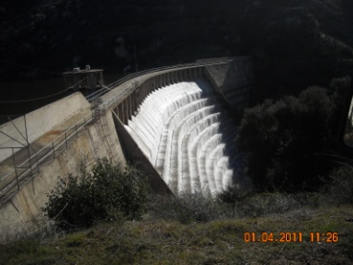

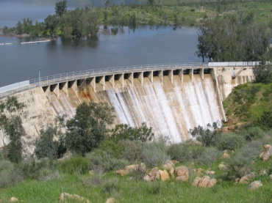
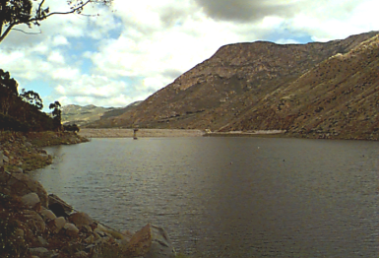
Service Area & Supply Reservoirs
Hodges
San Pasqual
Miramar
San Vicente
Morena
Lake Murray
La Jolla
Barrett
San Diego
Otay Mesa
Lower Otay
Sutherland
El Capitan

Slide 4
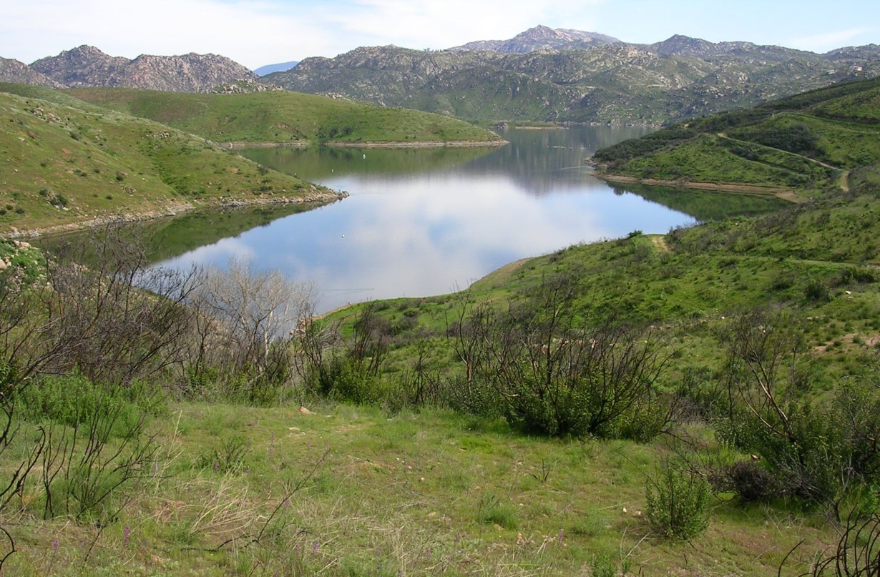
Surface Water Reservoirs
  Nine Surface Water Reservoirs
  Total Storage Capacity of 408,000 Acre Feet (AF)
  Current Storage is 255,000 AF (63% Full)
  Total Watershed Area is Approx. 973 Square Miles
  Average Runoff of 99,000 AF/YR
  Median Runoff of 43,000 AF/YR
  Average Evaporation of 23,000 AF/YR (Normal Levels)
  Average Local Water Use or Yield of 29,000 AF/YR (Approx. 17% of Current Demands )
  Six Reservoirs Connected to Imported Water System
  Three Reservoirs Not Connected to Imported Water System

Slide 5
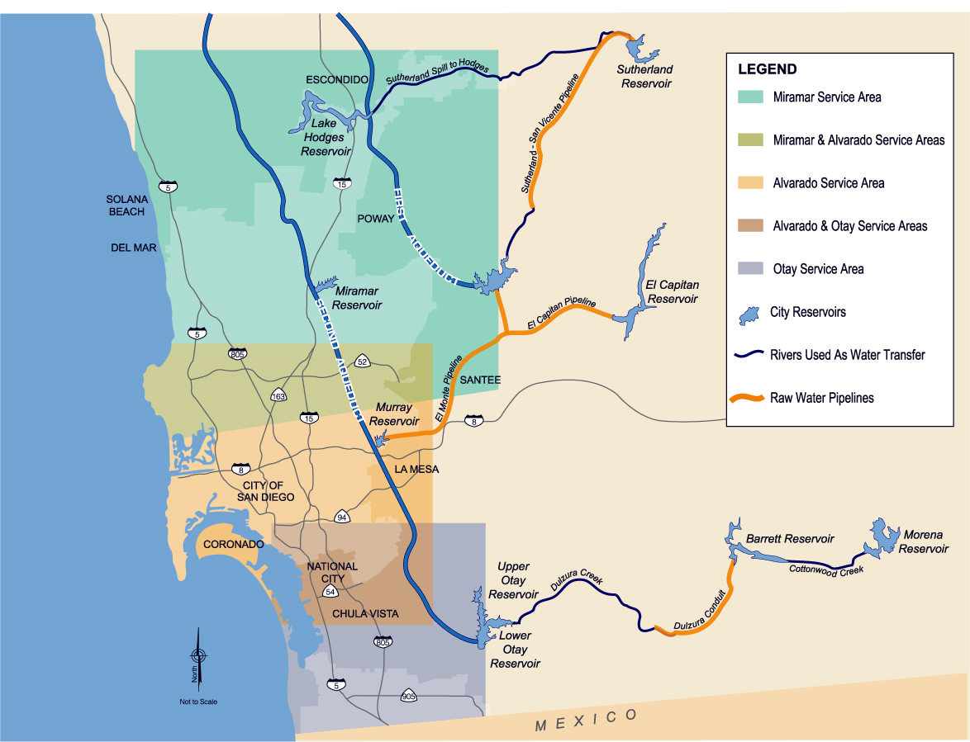
City of San Diego Water Supply and Distribution System

Slide 6
Surface Reservoir Operations Goals/Guidelines
City’s Reservoir Operations are Guided Mainly by the City’s Emergency Storage Council Policy CP 400-04
Emergency Storage Requirement per Council Policy 400-04
    Requires City to Maintain 7.2 Months of Upcoming Demand in Primary Storage
    Current Requirement Ranges Between 135,000 AF and 170,000 AF
General Reservoir Operations
  Optimize Imported Water Storage Programs (Short and Long Term), When Available
  Make Reservoirs Withdrawals Prior to the Rainy Season to Capture Runoff and Minimize Spill Potential
  Maximize Storage in San Vicente Reservoir
  Most Efficient Local Reservoir
  Centrally Located
  Connected to Imported Water System
  Connected to All Three City Water Treatment Plants (SDCWA’s Emergency Storage Project)
  New Hodges Connection

Slide 7
Primary Reservoir Storage
2008-2011

Slide 8
Frequency of Spills and Total Water
Spilled for the past 30 years
 | Reservoirs Total Spill in Acre Feet
Year of Spill | Morena | Barrett | Lower Otay | El Capitan | San Vicente | Sutherland | Hodges
1980 | 69,958 | 172,619 | 7,399 | 130,845 | 32,073 | 47,706 | 248,623
1981 | 4,557 | 3,192 |  |  |  |  | 30,720
1982 | 1,829 | 4,017 |  |  |  |  | 37,882
1983 | 132,429 | 206,002 | 30,204 | 32,727 | 7,384 | 14,933 | 175,547
1984 | 3,434 | 3,858 |  | 11,158 |  | 4,206 | 29,860
1986 |  |  |  |  |  |  | 14,080
1993 |  | 74,614 | 21,274 | 12,401 | 11,005 | 17,379 | 129,354
1994 |  | 24,309
1995 | 35,301 | 66,979 |  |  | 2,621 | 4,606 | 136,584
1998 |  |  | 12,497 |  |  |  | 82,918
2005 |  |  | 4,284 |  |  |  | 68,077
2011 |  | 20,230 |  |  |  |  | 38,287
Total | 6/30 | 6/30 | 5/30 | 4/30 | 4/30 | 5/30 | 11/30

Slide 9
QUESTIONS?

